Slide 1
Ohmstik Aerial Testing
and R&D
Research, Development, and Design by Michael Dickerson.
All Rights Reserved Copyright © GridTek Systems 2007

Slide 2


NEW TECHNOLOGY
SERIES
- Presented by -
- Presentation and Graphics by -

Slide 3
3’ hot stick operation
“Standard Operation”

Slide 4
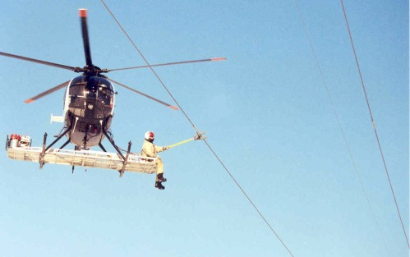

Slide 5
14’ stick & fulcrum arm operation
This method was developed for construction
where physical clearance would not allow
for the conventional 3’ stick approach.

Slide 6
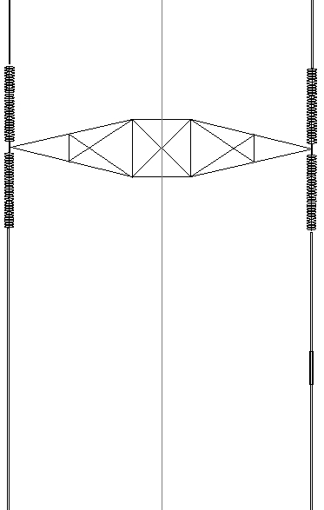
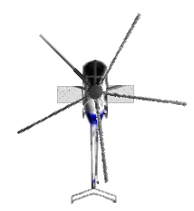
How it works…

Slide 7
How it works…

Slide 8
How it works…

Slide 9
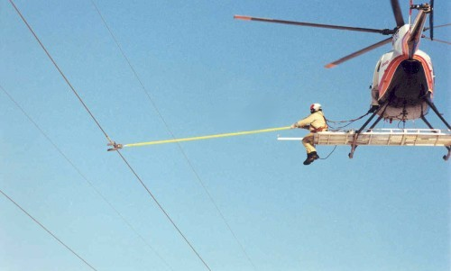

Slide 10
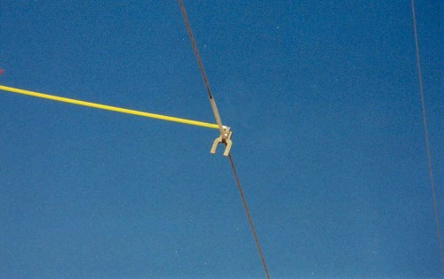

Slide 11
the long-line method
This method was developed for vertical construction
where physical clearance would not allow
for conventional aerial approach.
* Note - This method has been tested and been proven to work,
however its more time consuming than the previous two methods. More R&D
on this method needs to be done.

Slide 12
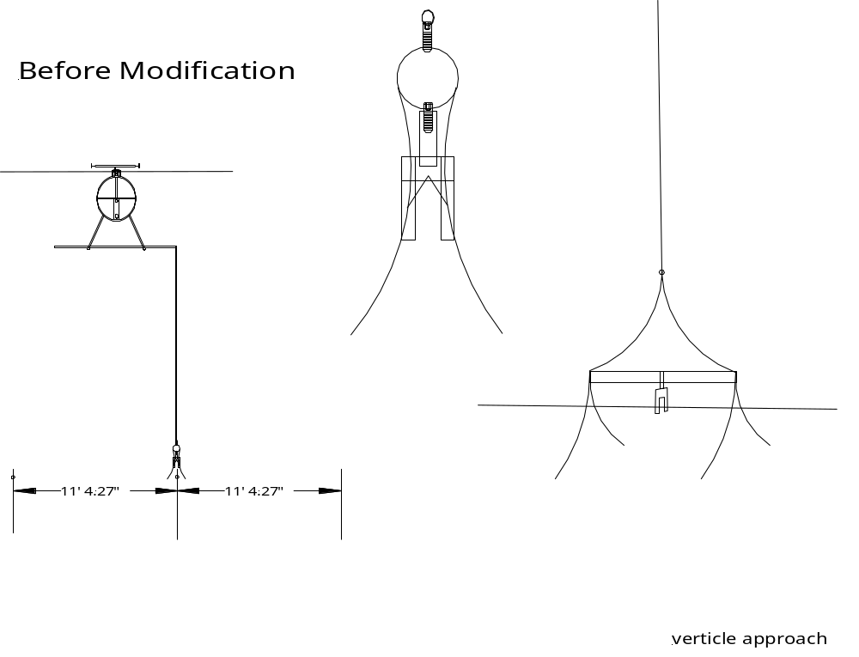
Line Long-Vertical method #1
Side view

Slide 13
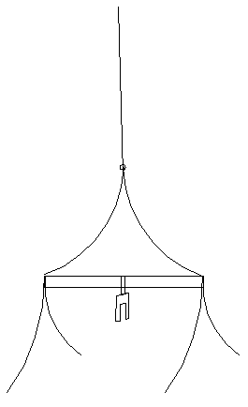
Line Long-Vertical method
All rights reserved Copyright 2004 © mdigital solutions

Slide 14
Line Long-Vertical method

Slide 15
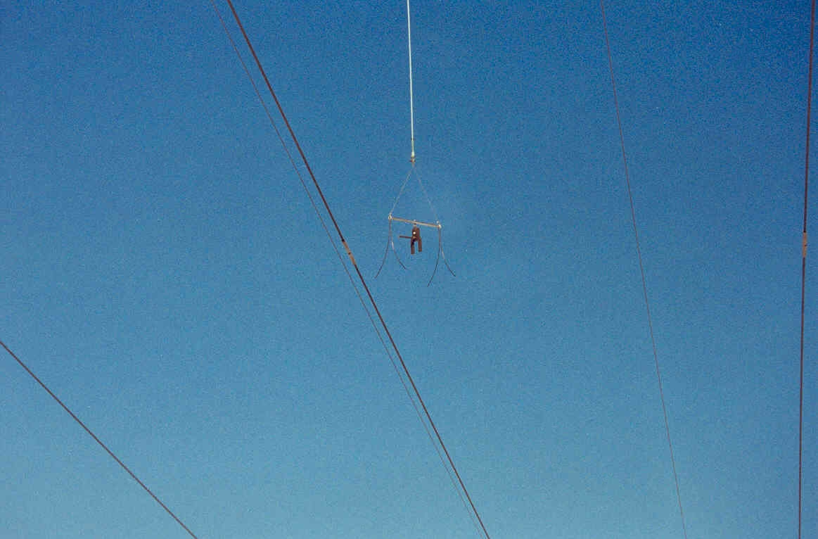

Slide 16
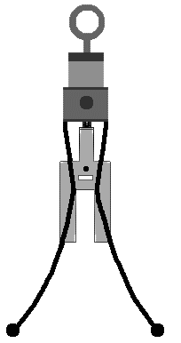
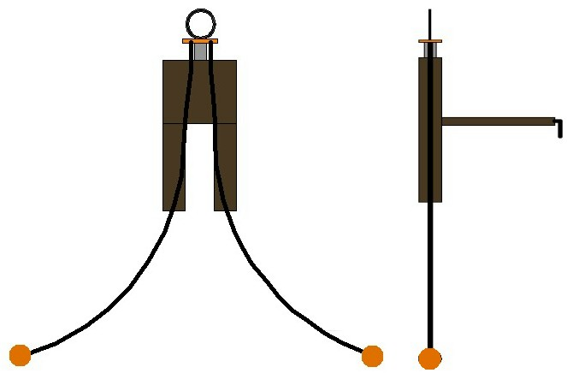
Line Long-Vertical method #2
Side View
Front View
Bundled Conductor
18” apart
* Note - This is a second prototype design that utilizes a single set of guide legs instead of two. Its intent is to make it easier to guide onto bundled conductor. The design also allow for the unit to self-balance itself to ensure a quicker reading.

Slide 17
This method was designed to access the middle
phase on lower voltage horizontal construction and
is still being fine-tuned.

Slide 18
The basic design(s) and concepts

Slide 19
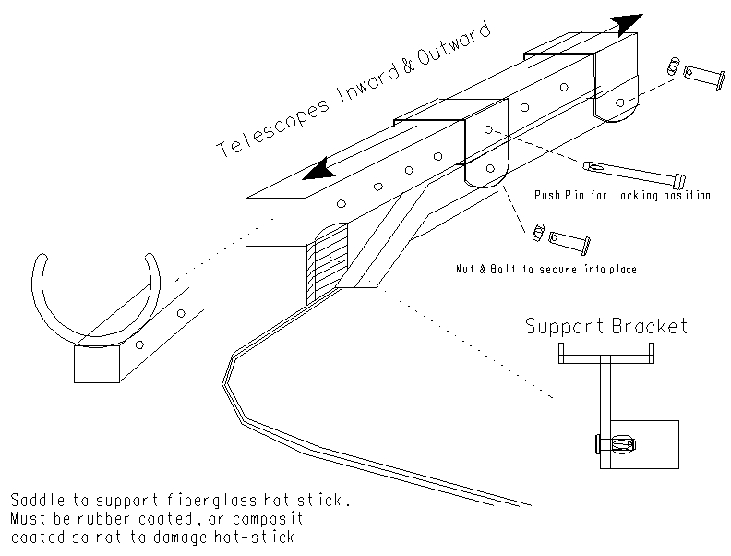
Platform Arm Bracket

Slide 20
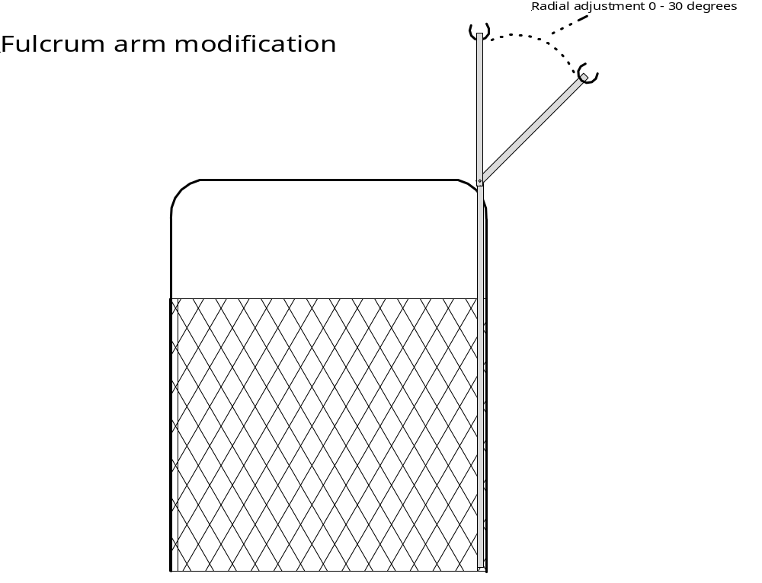
Top View of Arm Bracket
Telescopes in and out

Slide 21
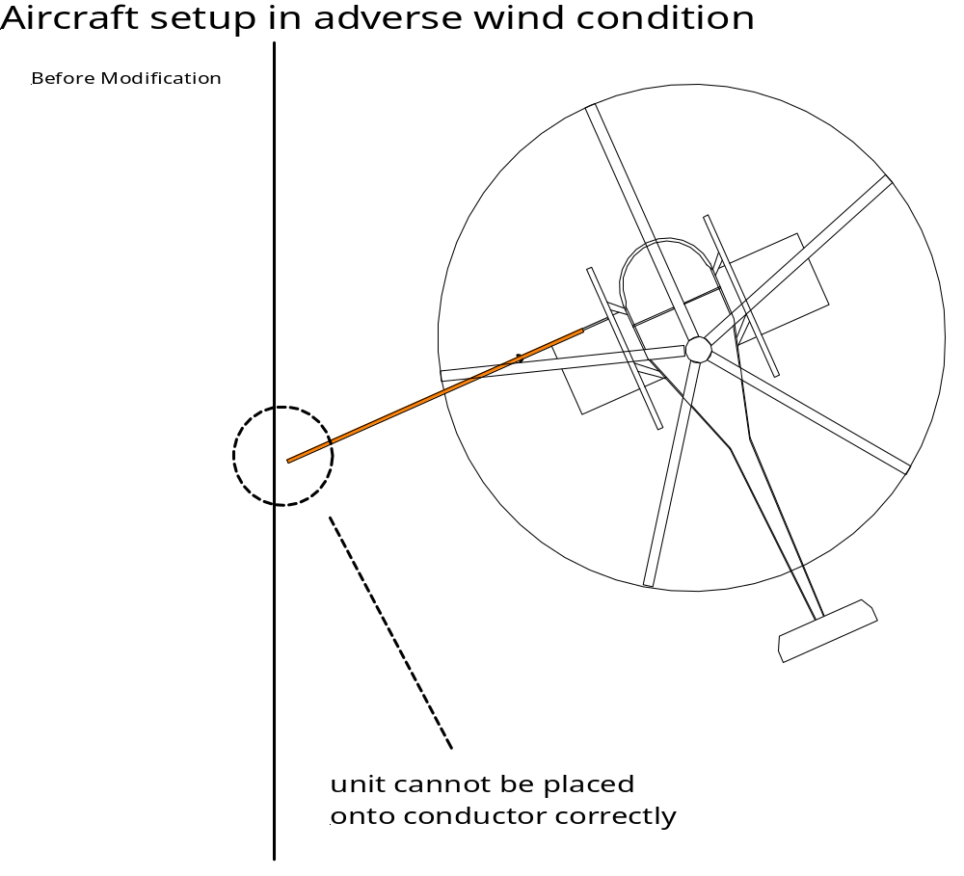
Without adjustable arm operation is
limited in wind conditions.
Unit cannot be placed onto sleeve correctly.

Slide 22
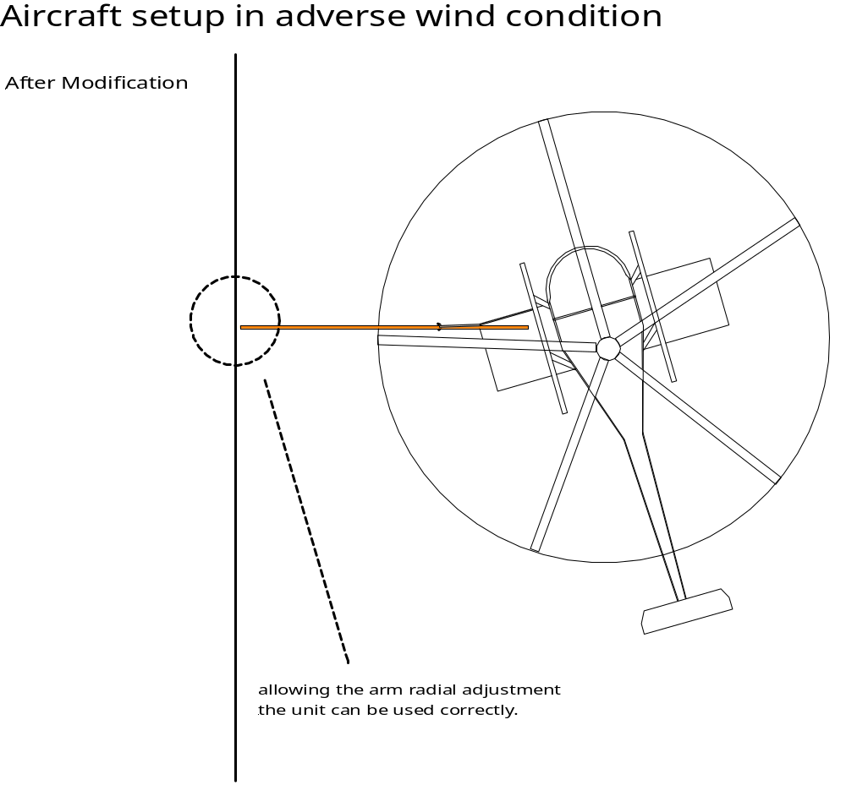
With the adjustable arm operation is
No longer limited in wind conditions.
Allowing the arm radial adjustment the unit can be fitted to sleeve in the correct position for a reading.

Slide 23
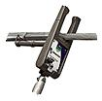
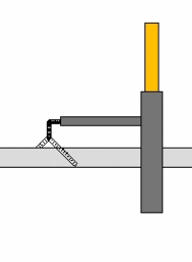
What we have found…
The current probe sensor is in the shape
of an “L” and makes it difficult for the
lineman to keep it in contact with the
conductor/sleeve.
Recommend designing a probe from 1/4”
threaded rod in the shape of a “T” or “V”
to be sure that probe is making good contact
with the sleeve or conductor.

Slide 24
Thank You…

